Slide 1

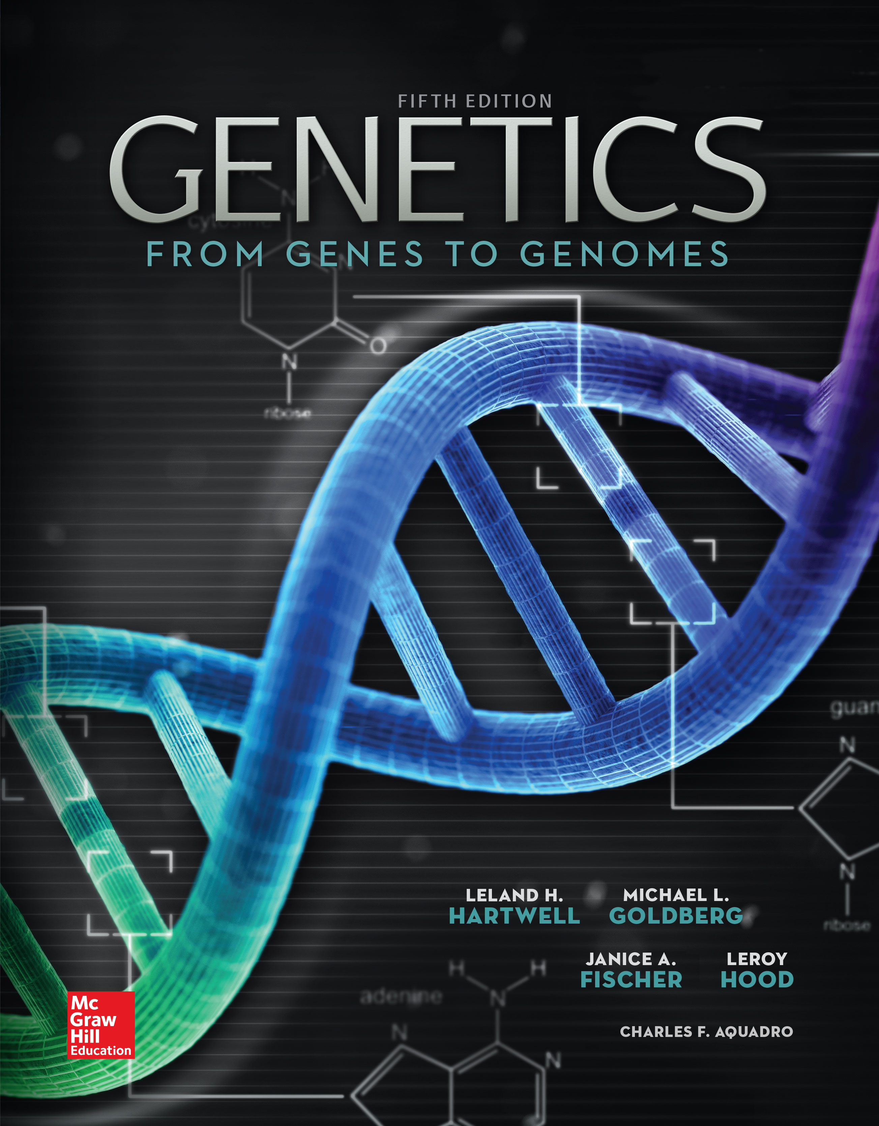
Genetics: From Genes to Genomes
Fifth Edition
Leland H. Hartwell, Michael L. Goldberg, Janice A. Fisher, Leroy Hood, and Charles F. Aquadro
Prepared by Kristin D. Patterson
University of Texas at Austin
Copyright © McGraw-Hill Education. Permission required for reproduction or display
1
Notes:
1

Slide 2
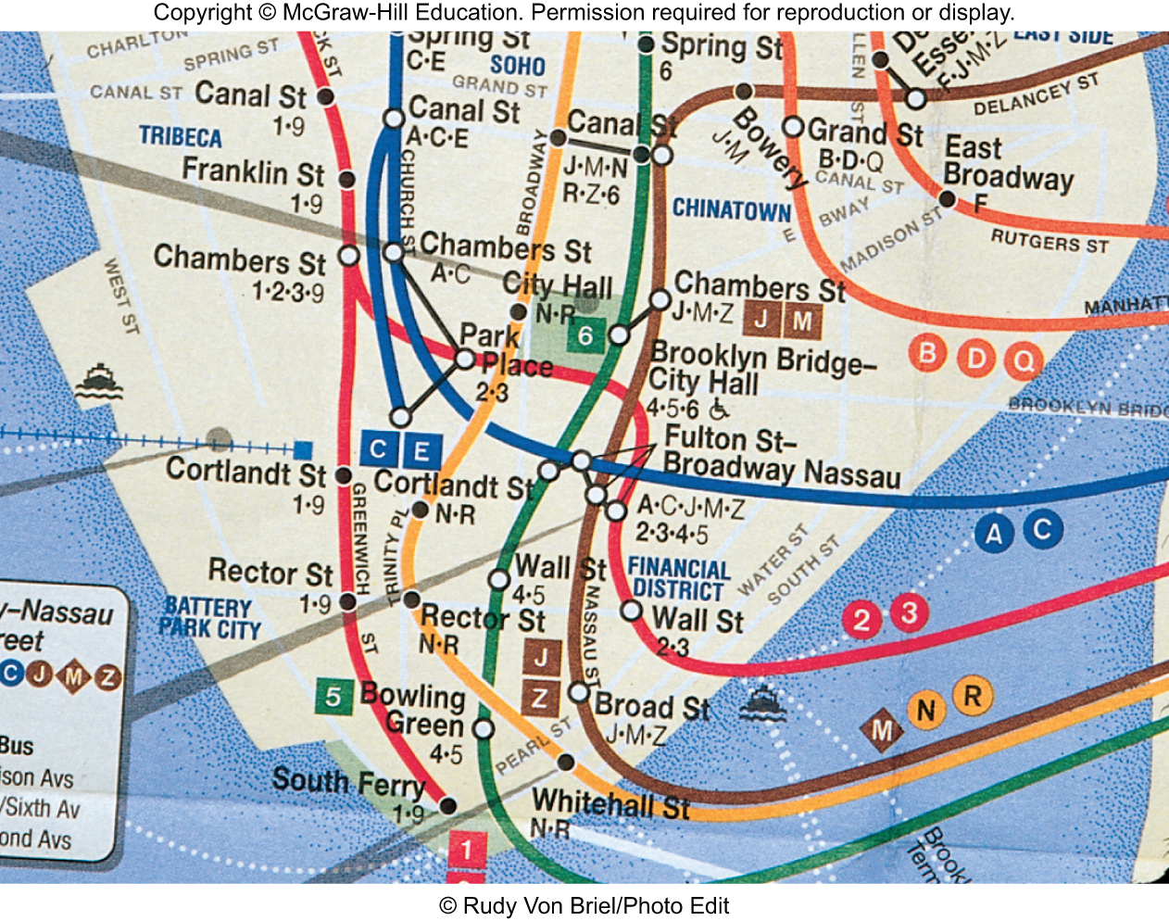
5
PART I
Basic Principles: How Traits Are Transmitted
CHAPTER
CHAPTER
Linkage, Recombination, and the Mapping of Genes on Chromosomes
CHAPTER OUTLINE
5.1 Gene Linkage and Recombination
5.2 Recombination: A Result of Crossing-Over During Meiosis
5.3 Mapping: Locating Genes Along a Chromosome
5.4 The Chi-Square Test and Linkage Analysis
5.5 Tetrad Analysis in Fungi
5.6 Mitotic Recombination and Genetic Mosaics
Copyright © McGraw-Hill Education. Permission required for reproduction or display
Hartwell et al., 5th ed., Chapter 5

Slide 3
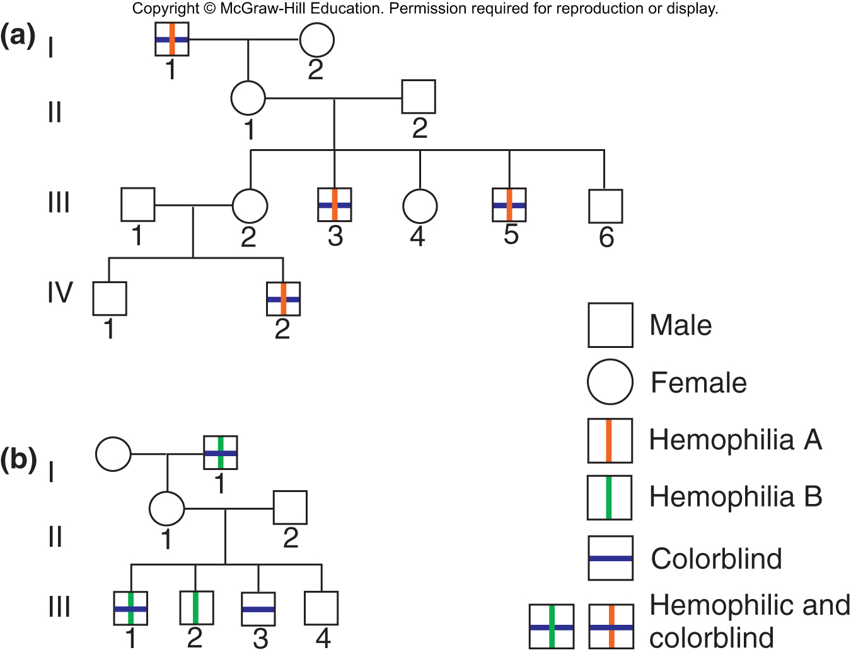
Linkage, recombination, and mapping of genes on chromosomes
Genes linked together on the same chromosome usually assort together
Linked genes may become separated by recombination
Copyright © McGraw-Hill Education. Permission required for reproduction or display
Hartwell et al., 5th ed., Chapter 5

Slide 4
5.1 Gene Linkage and Recombination
Learning objectives:
Define linkage with respect to gene loci and chromosomes.
Differentiate between parental and recombinant gametes.
Conclude from ratios of progeny in a dihybrid cross whether or not two genes are linked.
Explain how a testcross can provide evidence for or against linkage.
Copyright © McGraw-Hill Education. Permission required for reproduction or display
Hartwell et al., 5th ed., Chapter 5

Slide 5
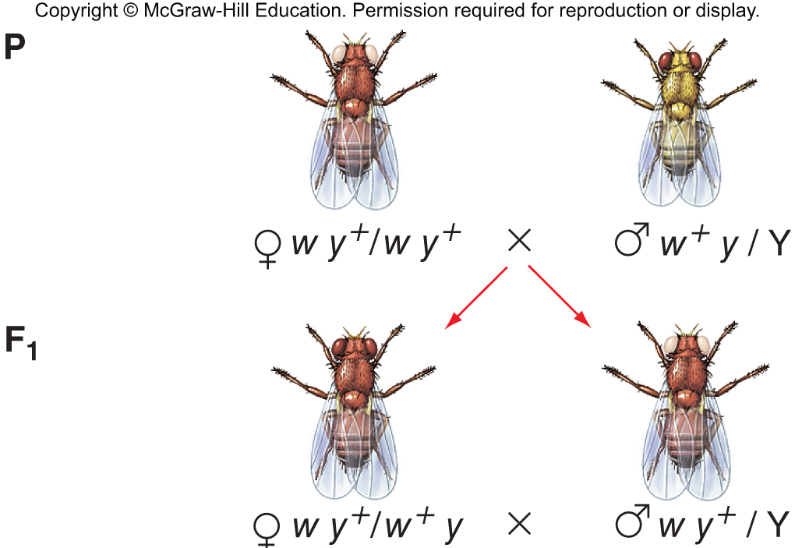
Detecting linkage by analyzing the progeny of dihybrid crosses: X-linked genes
Syntenic genes – genes located on the same chromosome
Two X-linked genes in Drosophila with recessive alleles
w⁺ (red eyes) and w (white eyes)
y⁺ (brown body) and y (yellow body)
Note that in this cross:
F₁ males get their only X chromosome from their mothers
F₁ females are dihybrids
Copyright © McGraw-Hill Education. Permission required for reproduction or display
Hartwell et al., 5th ed., Chapter 5

Slide 6
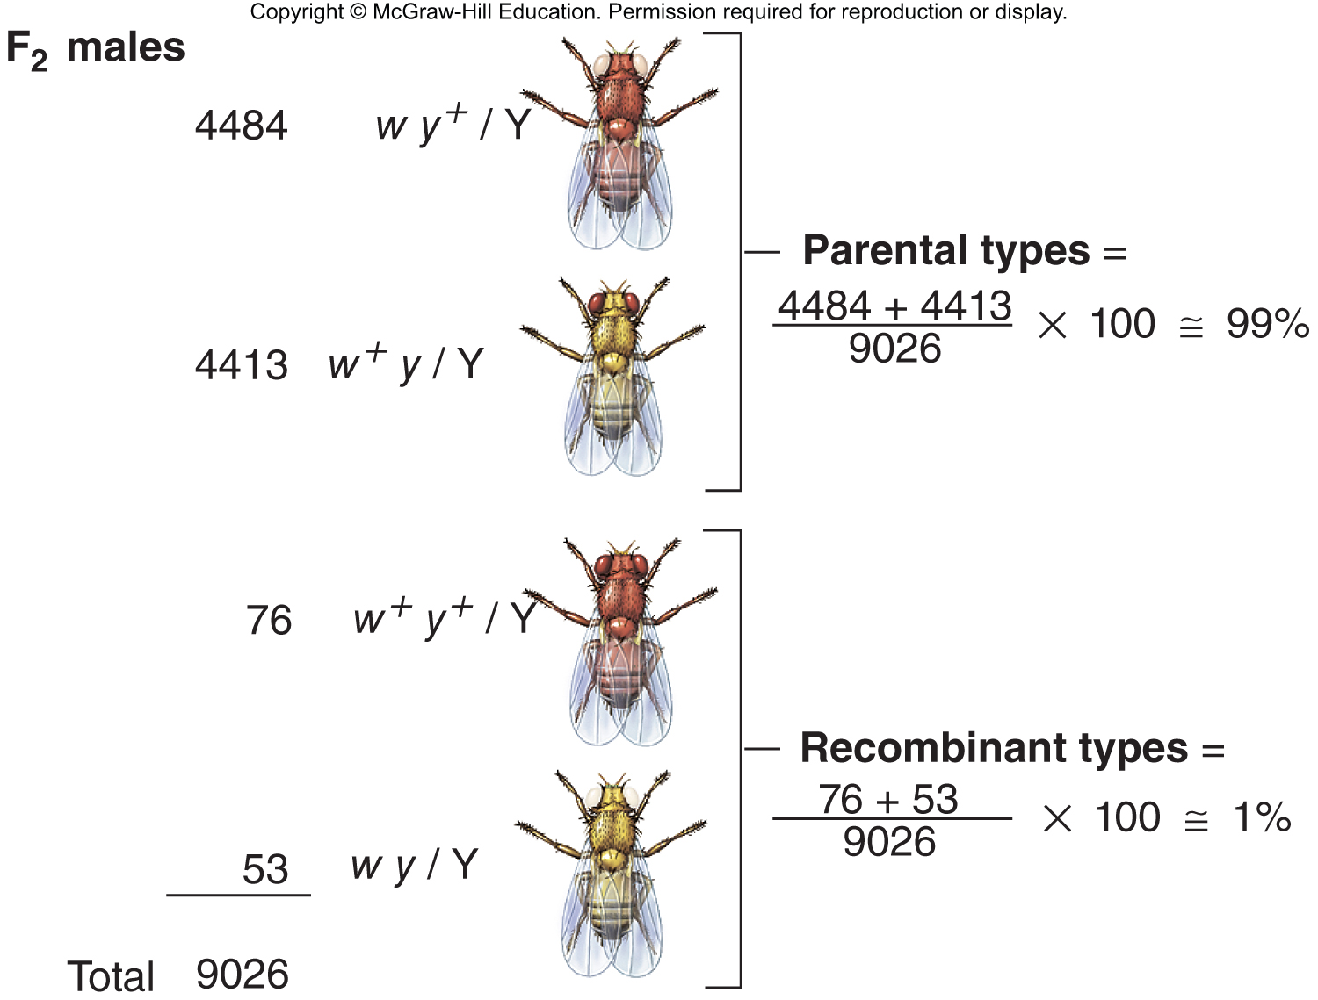
Detecting linkage by analyzing the progeny of dihybrid crosses: X-linked genes (cont)
Compare allele configurations in F₂ to P generation
Deviation from 1:1:1:1 segregation in F₂ indicates the genes are linked
Note that in this cross involving X-linked genes, only the F₂ male progeny were counted
Copyright © McGraw-Hill Education. Permission required for reproduction or display
Hartwell et al., 5th ed., Chapter 5

Slide 7
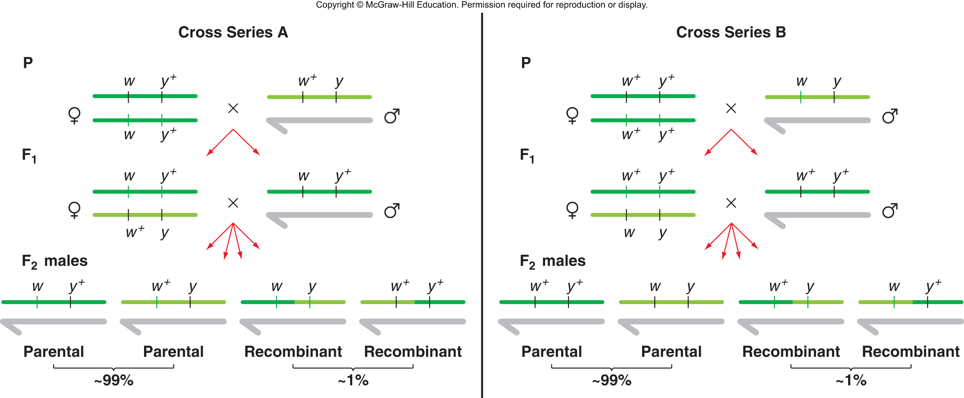
Designation of "parental" and "recombinant" relate to past history
Note that the parental configurations in these two crosses are opposite of each other
Copyright © McGraw-Hill Education. Permission required for reproduction or display
Hartwell et al., 5th ed., Chapter 5

Slide 8
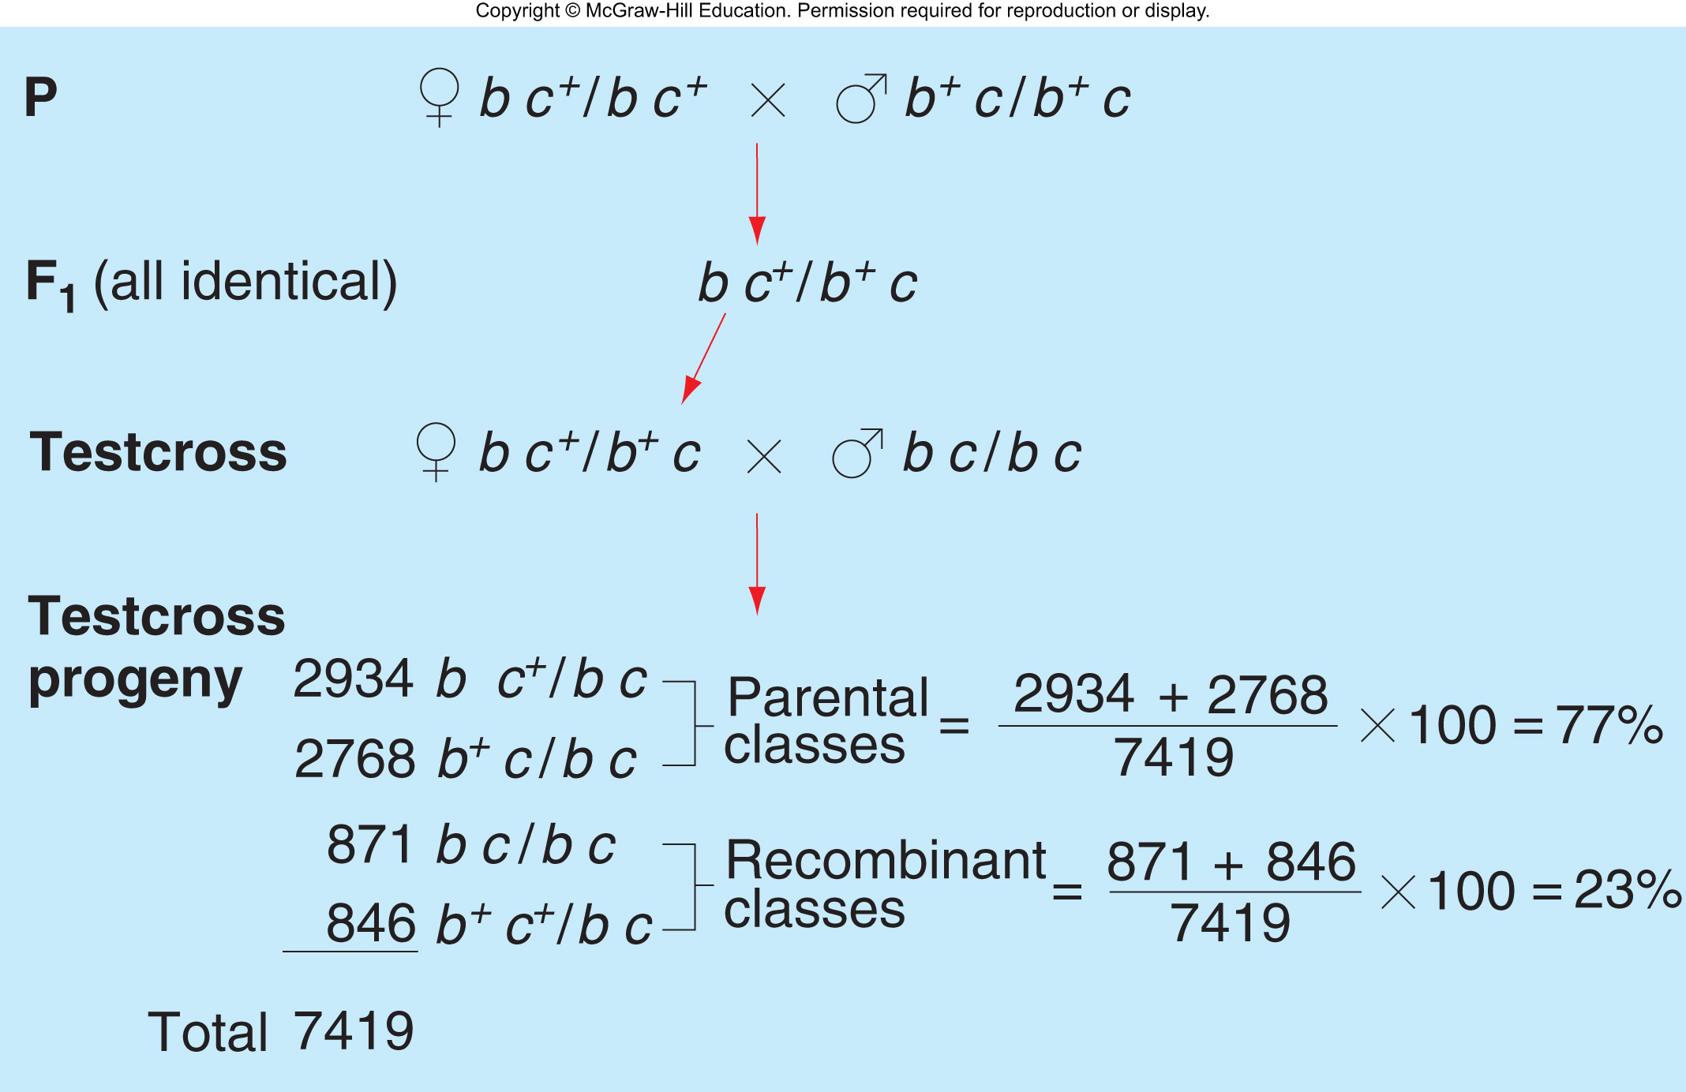
Autosomal genes can also exhibit linkage
Detect linkage by generating a double heterozygote and crossing to homozygous recessive (testcross)
Copyright © McGraw-Hill Education. Permission required for reproduction or display
Hartwell et al., 5th ed., Chapter 5

Slide 9
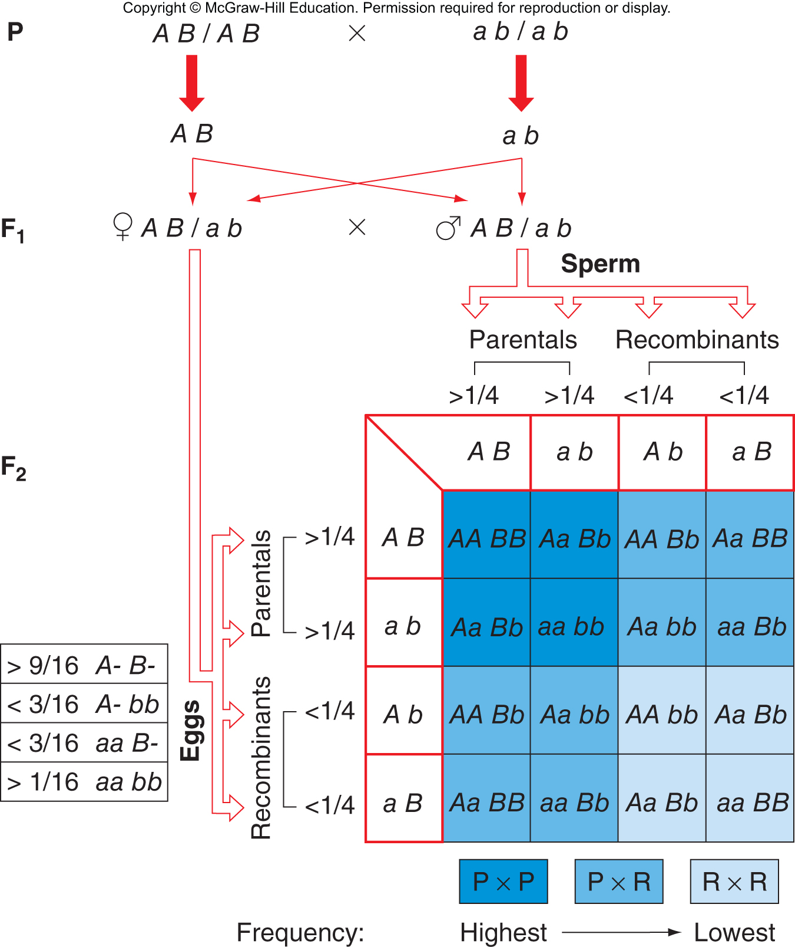
The expected 9:3:3:1 ratio of genotypes is altered when genes are linked
Copyright © McGraw-Hill Education. Permission required for reproduction or display
Hartwell et al., 5th ed., Chapter 5

Slide 10
5.2 Recombination: A Result of Crossing-Over During Meiosis
Learning objectives:
Explain the physical process by which recombination takes place.
Describe the role of chiasmata in chromosome segregation during meiosis.
Discuss the relationship between the recombination frequency and the map distance separating two loci.
Explain why the value of the recombination frequency is limited to 50%.
Copyright © McGraw-Hill Education. Permission required for reproduction or display
Hartwell et al., 5th ed., Chapter 5

Slide 11
Recombination: A result of crossing-over during meiosis
Frans Janssens – 1909, observed chiasmata at chromosomes during prophase of meiosis I
T. H. Morgan – suggested chiasmata were sites of chromosome breakage and exchange
H. Creighton and B. McClintock (corn) and C. Stern (Drosophila) – 1931, direct evidence that genetic recombination depends on reciprocal exchanged of chromosomes
Physical markers were used to identify specific chromosomes
Genetic markers were used as points of reference for recombination
Copyright © McGraw-Hill Education. Permission required for reproduction or display
Hartwell et al., 5th ed., Chapter 5

Slide 12
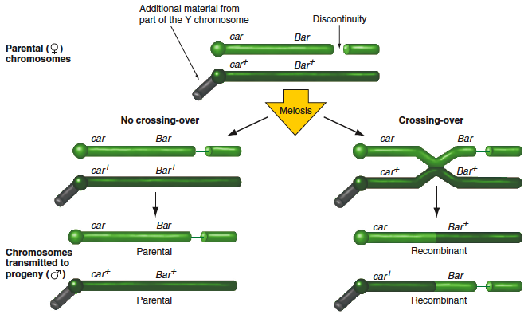
Evidence that recombination results from reciprocal exchanges between homologous chromosomes
Copyright © McGraw-Hill Education. Permission required for reproduction or display
Hartwell et al., 5th ed., Chapter 5

Slide 13
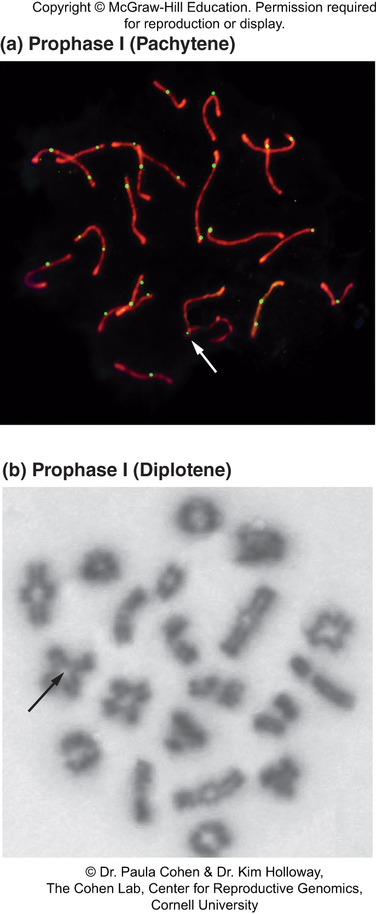
Recombination helps ensure proper chromosome segregation during meiosis I
Synaptonemal complexes help homologous chromosomes pair, but they disappear during prophase I.
Chromosomes are still attached by chiasmata and cohesin.
Copyright © McGraw-Hill Education. Permission required for reproduction or display
Hartwell et al., 5th ed., Chapter 5

Slide 14
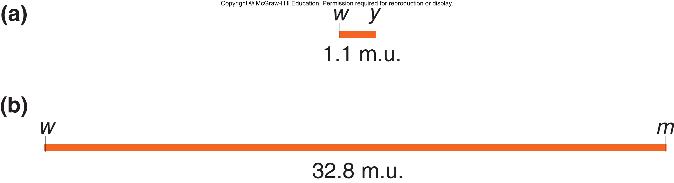
Recombination frequencies are the basis of genetic maps
H. Sturtevant – proposed that recombination frequencies (RF) could be used as a measure of physical distance between two linked genes
1 %RF = 1 map unit (m.u.) = 1 centiMorgan (cM)
Copyright © McGraw-Hill Education. Permission required for reproduction or display
Hartwell et al., 5th ed., Chapter 5

Slide 15
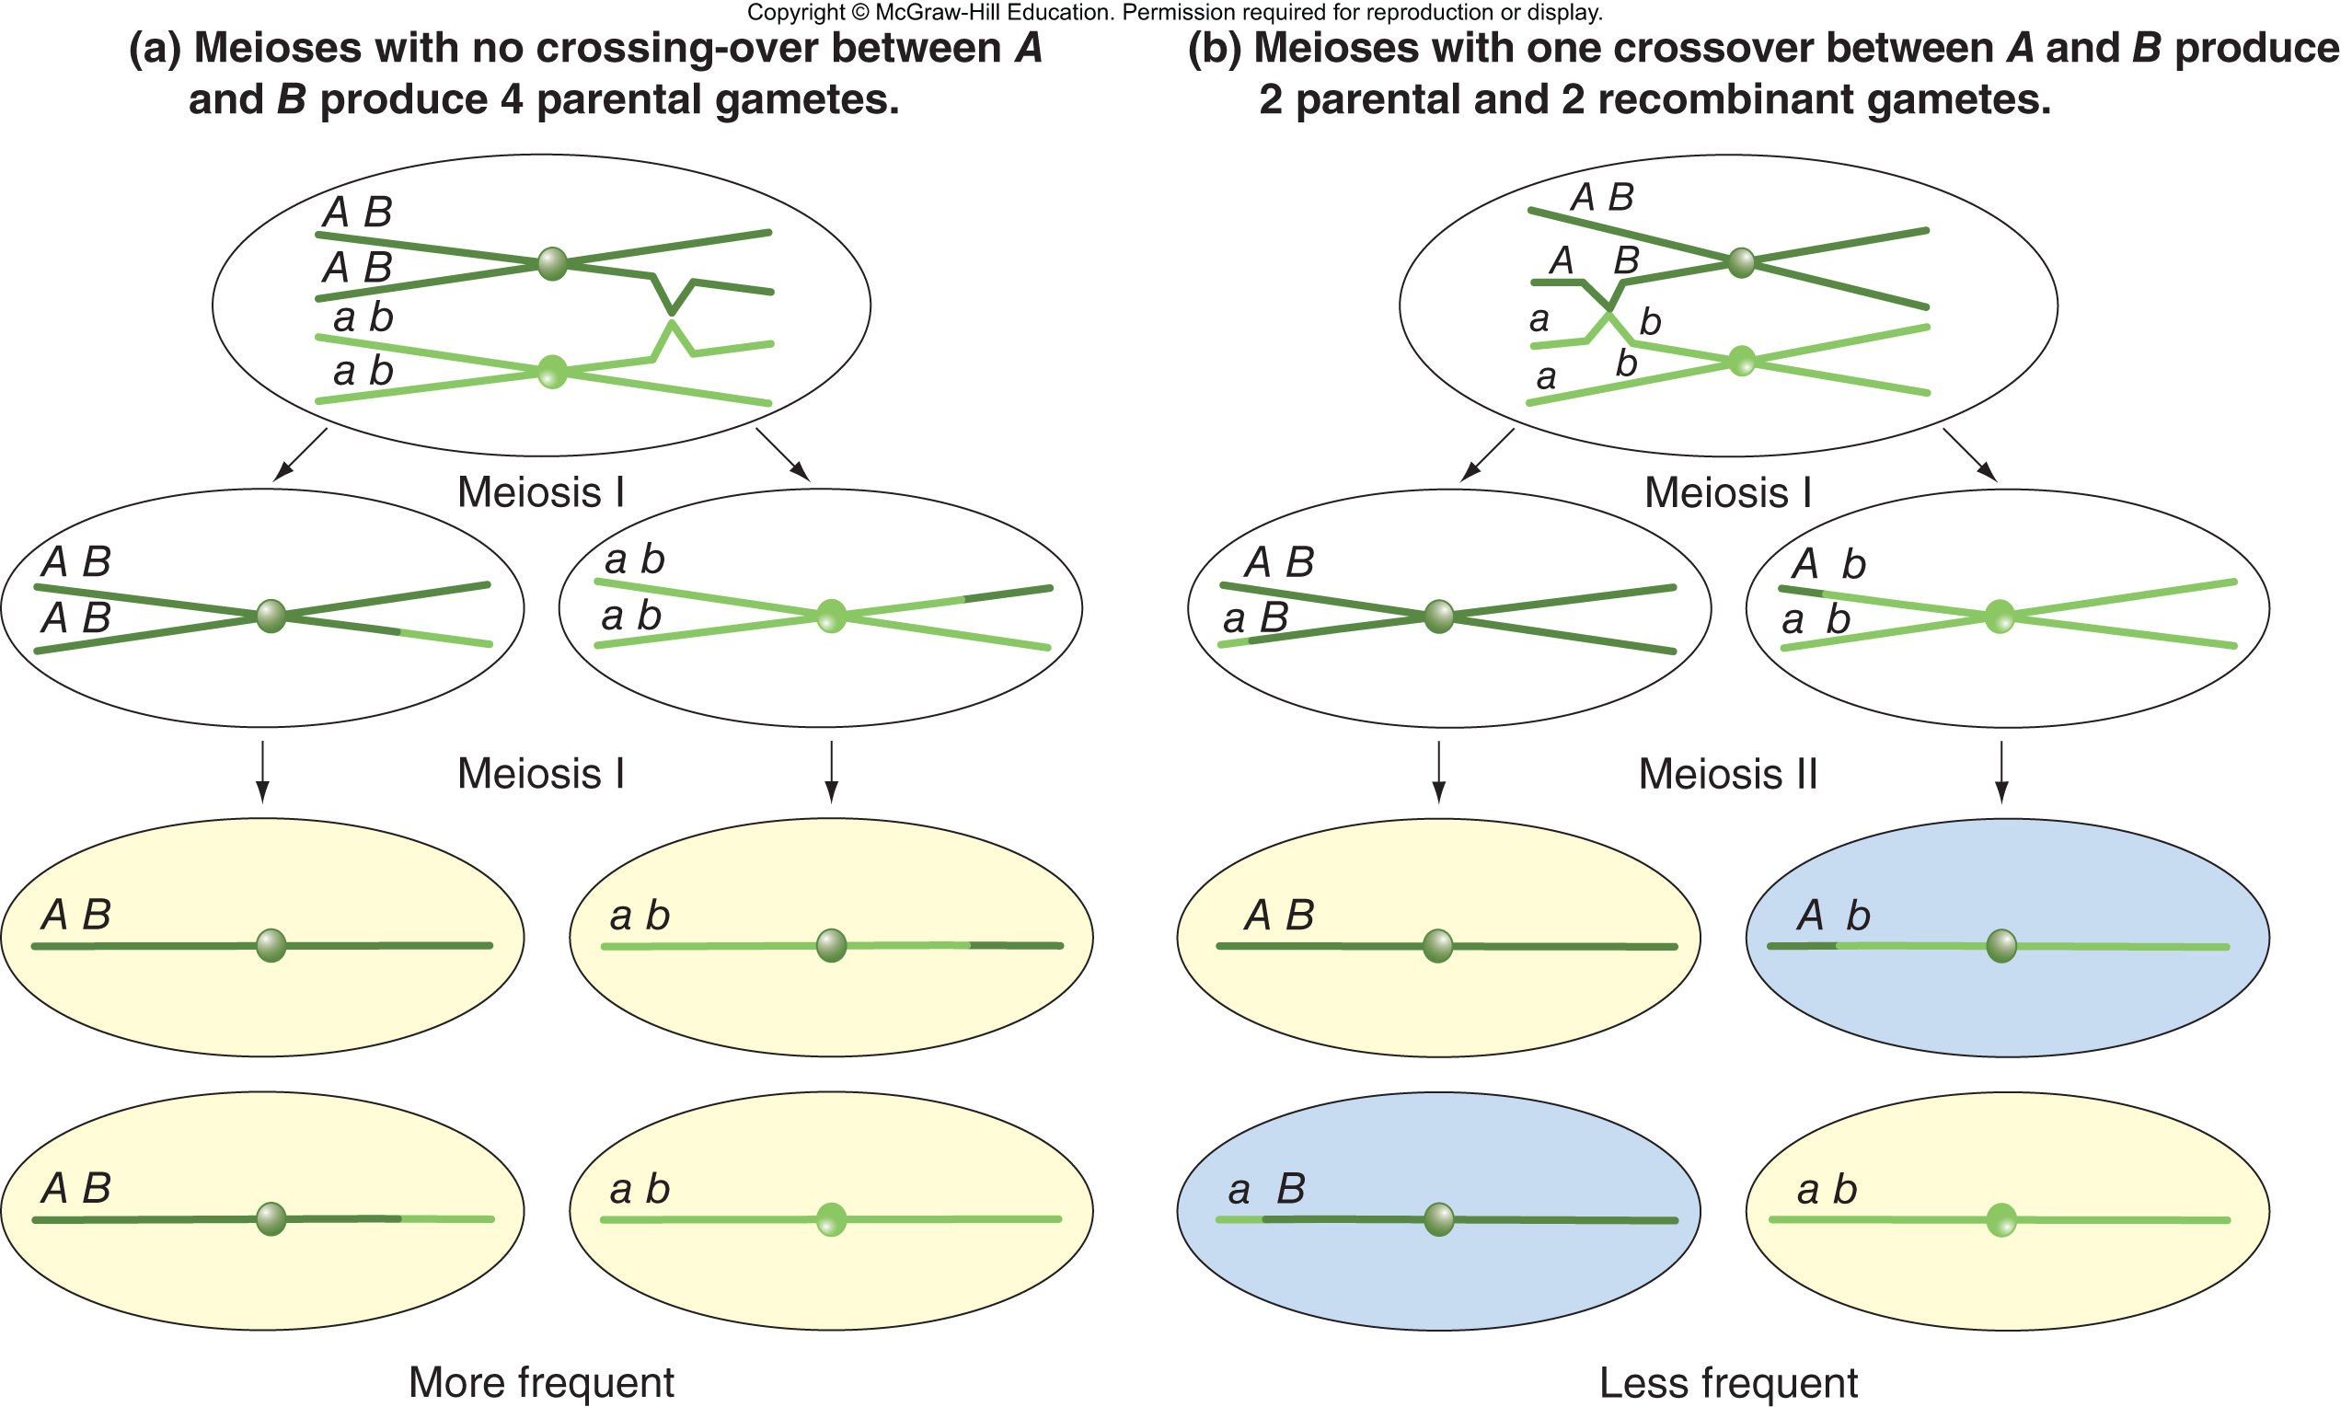
Recombinant gametes are less frequent than parental gametes when genes are linked
Copyright © McGraw-Hill Education. Permission required for reproduction or display
Hartwell et al., 5th ed., Chapter 5

Slide 16
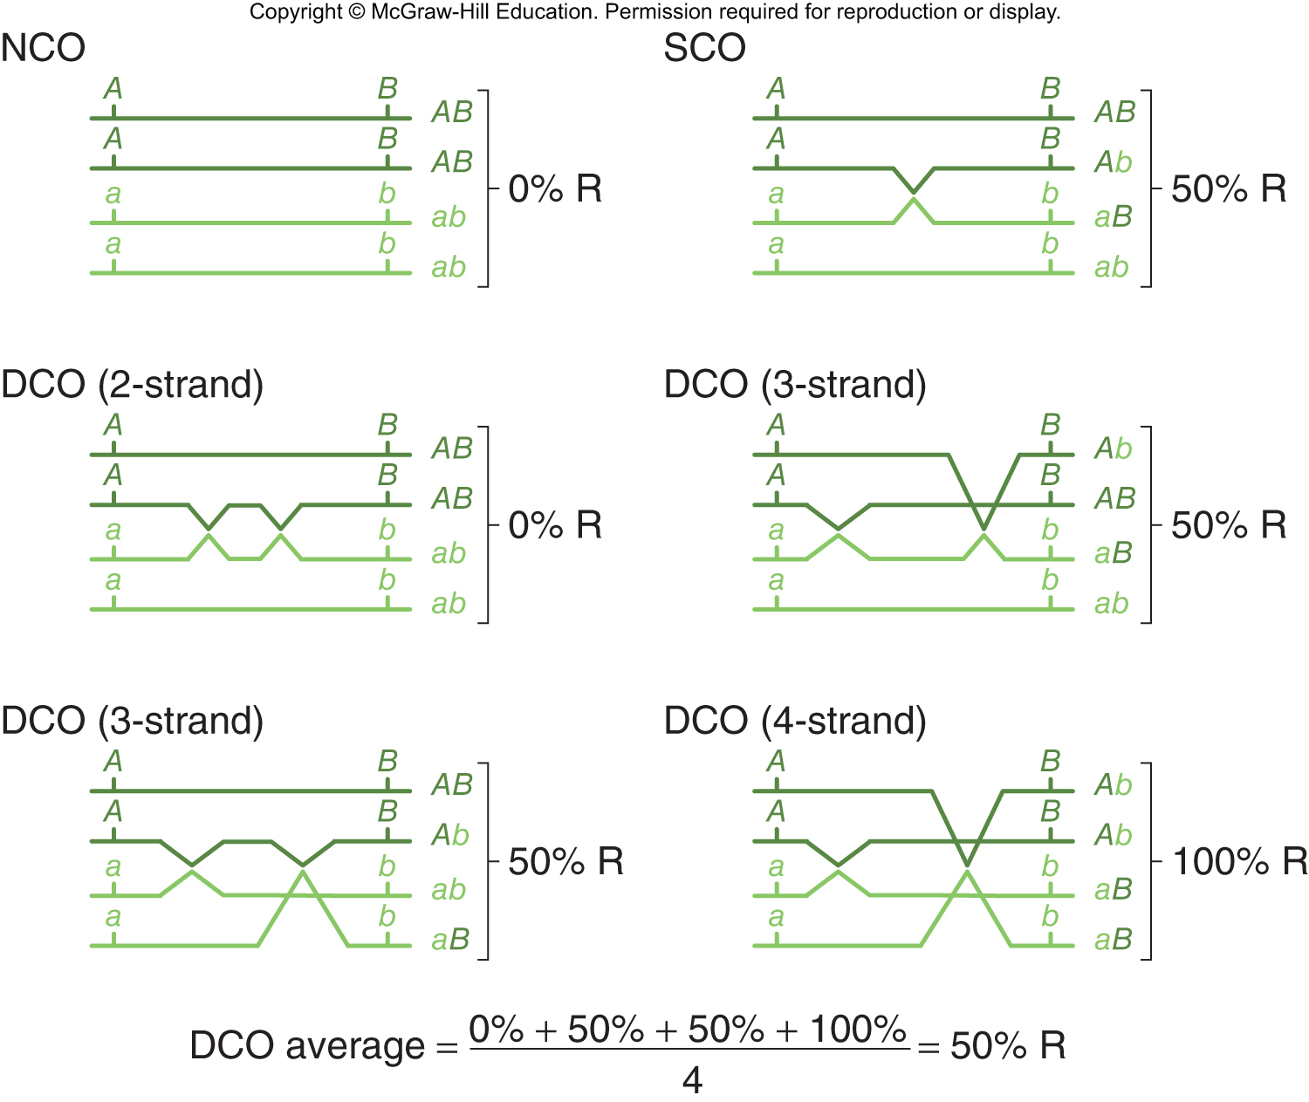
Recombination frequencies between two genes never exceed 50%
The RF of unlinked genes is 50% due to independent assortment.
The RF of linked genes cannot exceed 50%
Meioses without crossovers produce only parental chromosomes.
Single and double crossovers produce a 1:1 parental to recombinant chromosome ratio on average.
Copyright © McGraw-Hill Education. Permission required for reproduction or display
Hartwell et al., 5th ed., Chapter 5

Slide 17
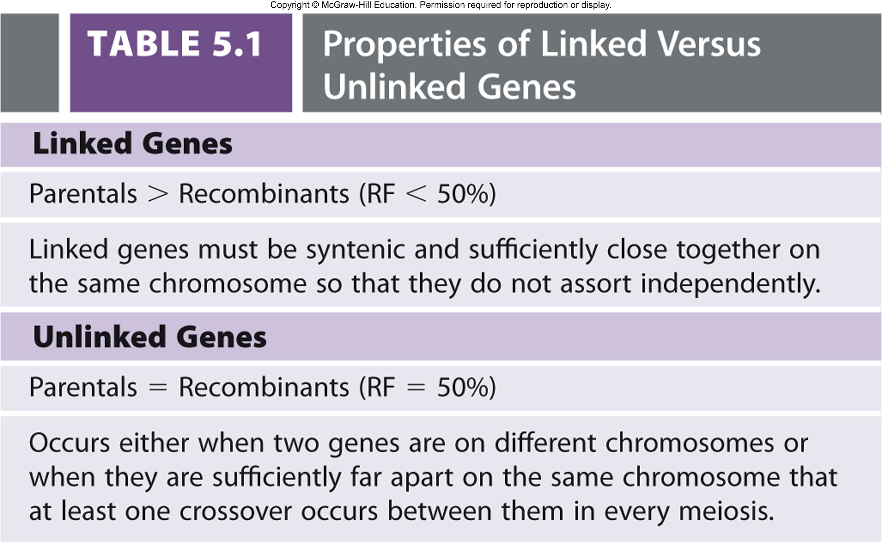
Properties of linked versus unlinked genes
Copyright © McGraw-Hill Education. Permission required for reproduction or display
Hartwell et al., 5th ed., Chapter 5

Slide 18
5.3 Mapping: Locating Genes Along a Chromosome
Learning objectives:
Establish relative gene positions using two-point cross data.
Refine genetic maps based on data from three-point testcrosses.
Explain how a genetic map (in map units) is related to physical distance (in base pairs of DNA).
Describe the relationship between linkage groups and chromosomes.
Copyright © McGraw-Hill Education. Permission required for reproduction or display
Hartwell et al., 5th ed., Chapter 5

Slide 19
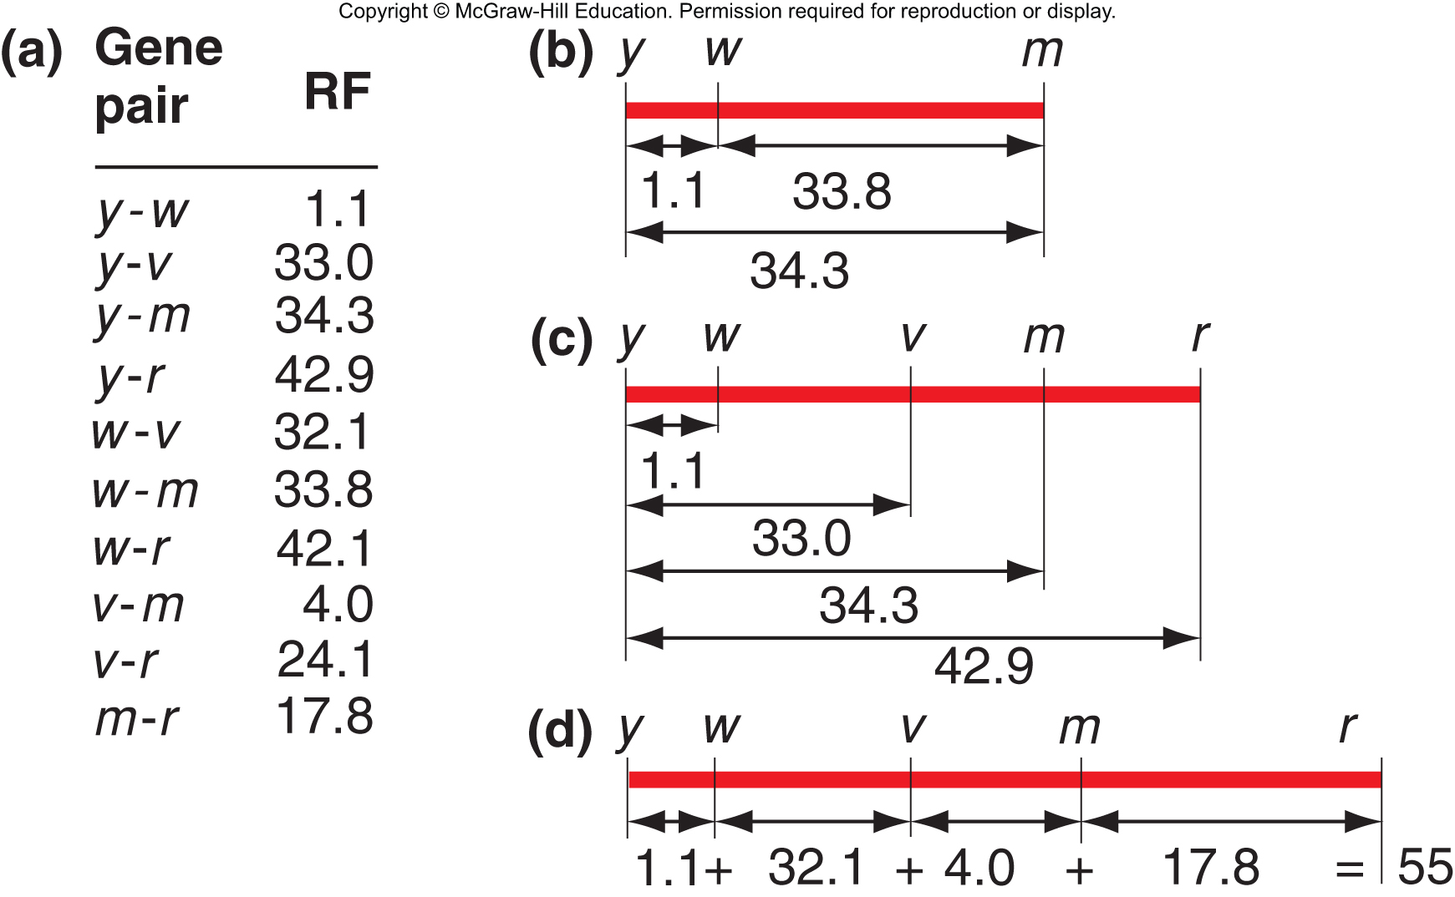
Mapping genes by comparisons of two-point crosses
Left-right orientation of map is arbitrary
Most accurate maps obtained by summing many small intervening distances
Copyright © McGraw-Hill Education. Permission required for reproduction or display
Hartwell et al., 5th ed., Chapter 5

Slide 20
Limitations of two point crosses
Difficult to determine gene order if two genes are close together
Actual distances between genes do not always add up
Pairwise crosses are time and labor consuming
Copyright © McGraw-Hill Education. Permission required for reproduction or display
Hartwell et al., 5th ed., Chapter 5

Slide 21
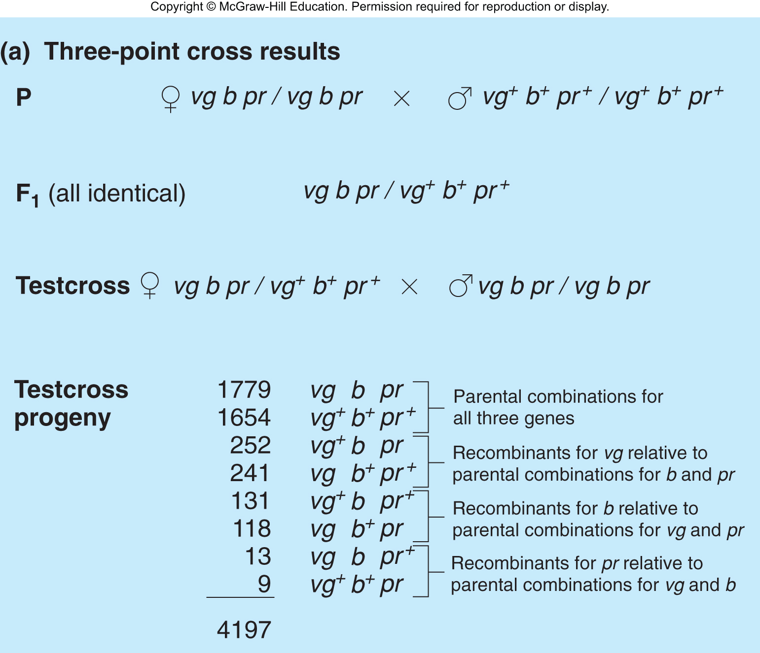
Three point crosses provide faster and more accurate mapping
Testcross of triply-heterozygous F₁
Copyright © McGraw-Hill Education. Permission required for reproduction or display
Hartwell et al., 5th ed., Chapter 5

Slide 23
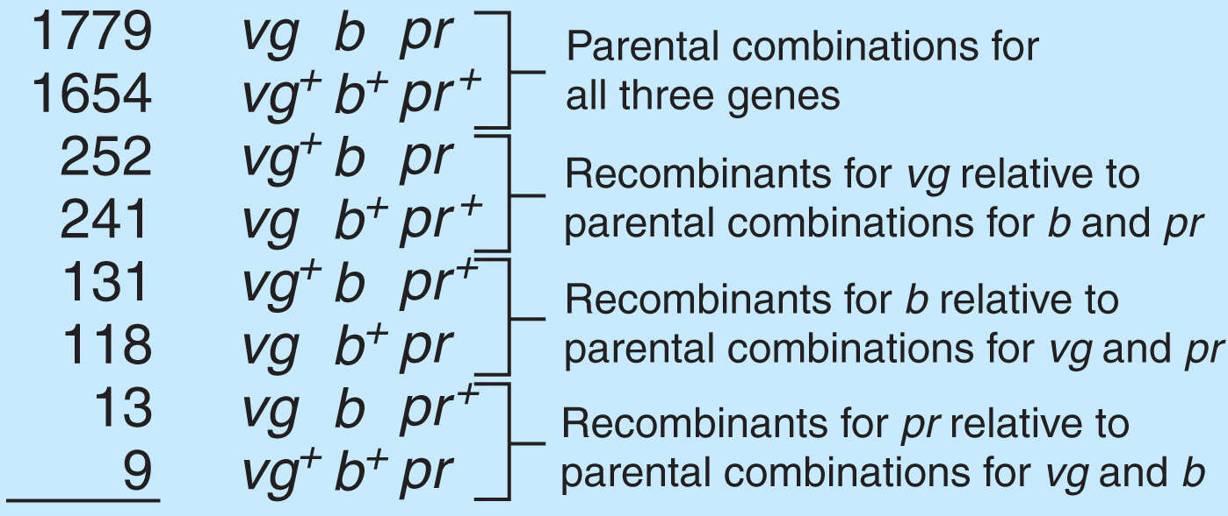
Analyzing the results of a three-point cross
Testcross progeny have four sets of reciprocal pairs of genotypes
Most frequent pair has parental configuration of alleles
Least frequent pair results from double crossovers
Examination of double crossover class reveals which gene is in the middle
Fig. 5.10
Copyright © McGraw-Hill Education. Permission required for reproduction or display
Hartwell et al., 5th ed., Chapter 5

Slide 24
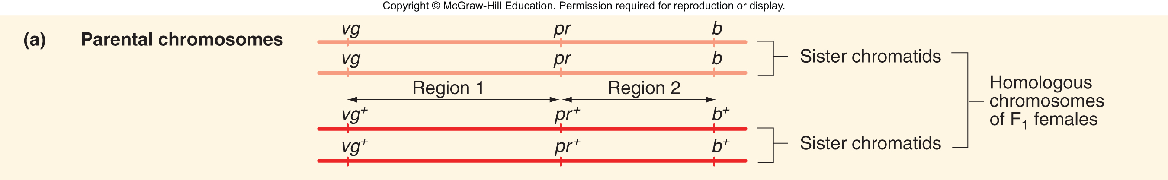
Inferring the location of crossover event
Examine numbers of progeny
Compare configuration of alleles at two genes at a time to parental configuration
Copyright © McGraw-Hill Education. Permission required for reproduction or display
Hartwell et al., 5th ed., Chapter 5

Slide 25
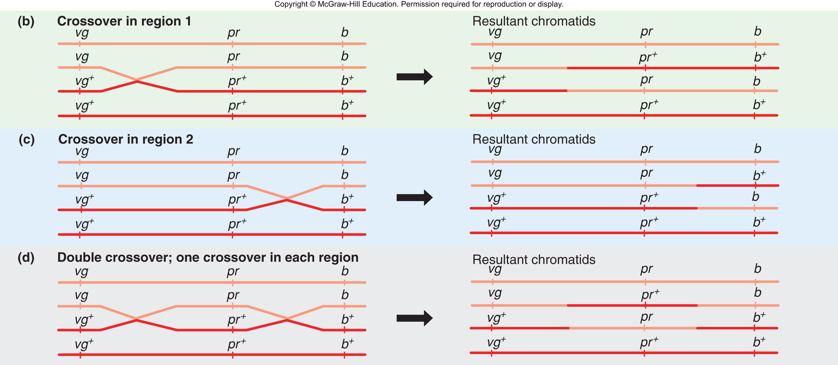
Inferring the location of crossover events (cont)
Copyright © McGraw-Hill Education. Permission required for reproduction or display
Hartwell et al., 5th ed., Chapter 5

Slide 26
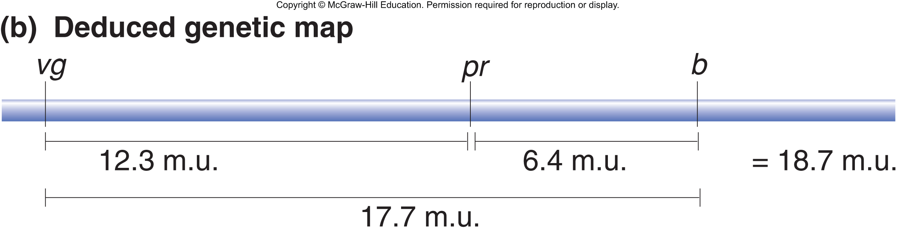
Genetic map deduced from three-point cross in Figure 5.12
Copyright © McGraw-Hill Education. Permission required for reproduction or display
Hartwell et al., 5th ed., Chapter 5

Slide 27
Correction for double crossovers
This calculation isn't accurate because it fails to account for double crossovers
Correct calculation that accounts for double crossovers
Copyright © McGraw-Hill Education. Permission required for reproduction or display
Hartwell et al., 5th ed., Chapter 5

Slide 28
Interference: The number of double crossovers may be less than expected
Chromosomal interference – occurrence of crossover in one portion of a chromosome interferes with crossover in an adjacent part of the chromosome
Not uniform between chromosomes or within a chromosome
Compare observed and expected frequencies of double crossovers (DCO)
Copyright © McGraw-Hill Education. Permission required for reproduction or display
Hartwell et al., 5th ed., Chapter 5

Slide 29
Calculation of interference in the three-point cross in Figure 5.12
Expected probability of double crossovers is the product of the single crossover frequencies in each interval
Probability of single crossover between vg and pr is 0.123 (12.3 m.u.)
Probability of single crossover between pr and b is 0.064 (6.4 m.u.)
If interference = 0, crossovers in adjacent regions occur independently of each other
If interference = 1, no double crossovers occur
Copyright © McGraw-Hill Education. Permission required for reproduction or display
Hartwell et al., 5th ed., Chapter 5

Slide 30
Calculation of interference in the three-point cross in Figure 5.12 (cont)
Expected probability of double crossovers
Observed proportion of double crossovers
Copyright © McGraw-Hill Education. Permission required for reproduction or display
Hartwell et al., 5th ed., Chapter 5

Slide 31
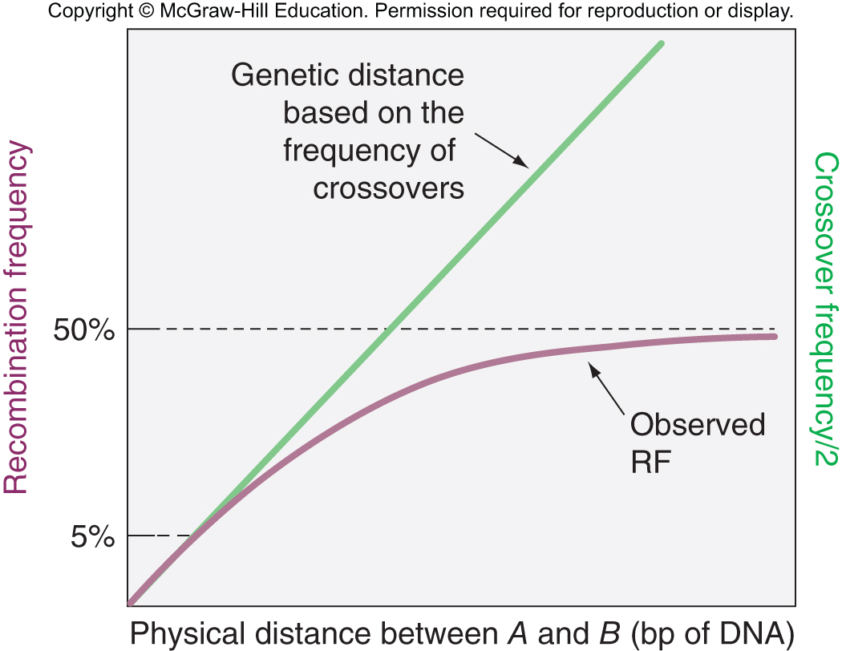
Do genetic maps correlate with physical reality?
Order of genes revealed by genetic mapping corresponds to the actual order of genes along the chromosome
Actual physical distance (amount of DNA) does not always show direct correspondence to genetic distance
Double, triple, and more crossovers
50% limit on observable recombination frequency
Recombination hotspots
Copyright © McGraw-Hill Education. Permission required for reproduction or display
Hartwell et al., 5th ed., Chapter 5

Slide 32
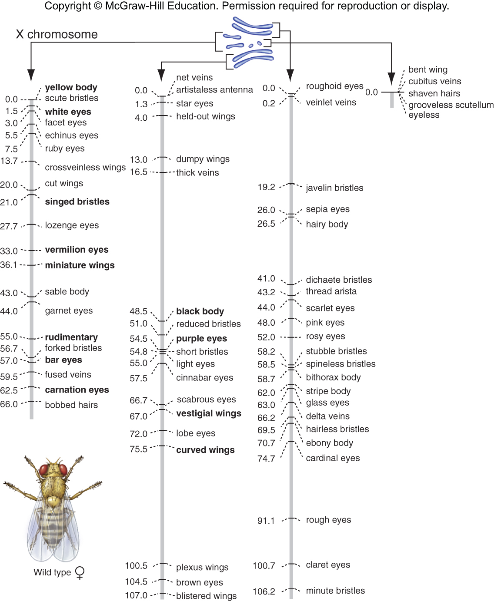
Drosophila melanogaster has four linkage groups
When many genes per chromosome have been mapped, a linkage group is synonymous with a chromosome
Copyright © McGraw-Hill Education. Permission required for reproduction or display
Hartwell et al., 5th ed., Chapter 5

Slide 33
5.4 The Chi-Square Test and Linkage Analysis
Learning objectives:
Explain the purpose of the chi-square test.
Discuss the concept of the null hypothesis and its use in data analysis.
Evaluate the significance of experimental data based on the chi-square test.
Copyright © McGraw-Hill Education. Permission required for reproduction or display
Hartwell et al., 5th ed., Chapter 5

Slide 34
Chi square test pinpoints the probability that ratios are evidence of linkage
Deviations from 1:1:1:1 ratios can represent chance events or linkage
Chi square test measures "goodness of fit" between observed and expected values
Null hypothesis – observed values are no different from expected values
In linkage studies, the null hypothesis is no linkage
If genes are not linked, expect 1:1:1:1 ratio in F₂ progeny
Chi-square test can reject the null hypothesis, but it cannot prove a hypothesis
Copyright © McGraw-Hill Education. Permission required for reproduction or display
Hartwell et al., 5th ed., Chapter 5

Slide 35
Information needed for the chi-square test
Use data from breeding experiment
Total number of progeny
How many classes of progeny
Number of offspring observed in each class
Calculate number of offspring expected in each class if there is no linkage (1:1:1:1 segregation)
Copyright © McGraw-Hill Education. Permission required for reproduction or display
Hartwell et al., 5th ed., Chapter 5

Slide 36
Applying the chi-square test
Calculate the chi-square
Consider degrees of freedom (df) in the experiment
df = N – 1 (where N is the number of classes)
Determine a p value using chi-square value and df
Probability that the deviation from expected numbers had occurred by chance
Use table 5.1
Copyright © McGraw-Hill Education. Permission required for reproduction or display
Hartwell et al., 5th ed., Chapter 5

Slide 37
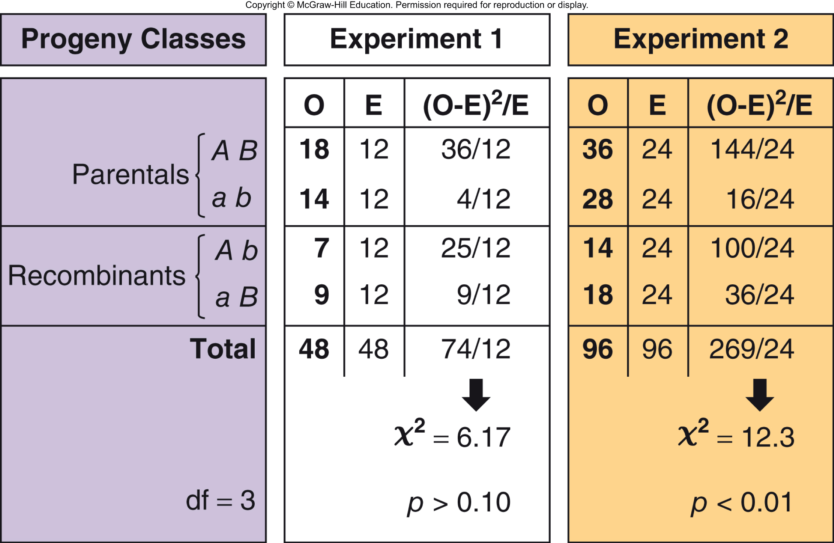
Applying the chi-square test to see if genes A and B are linked
Copyright © McGraw-Hill Education. Permission required for reproduction or display
Hartwell et al., 5th ed., Chapter 5

Slide 38
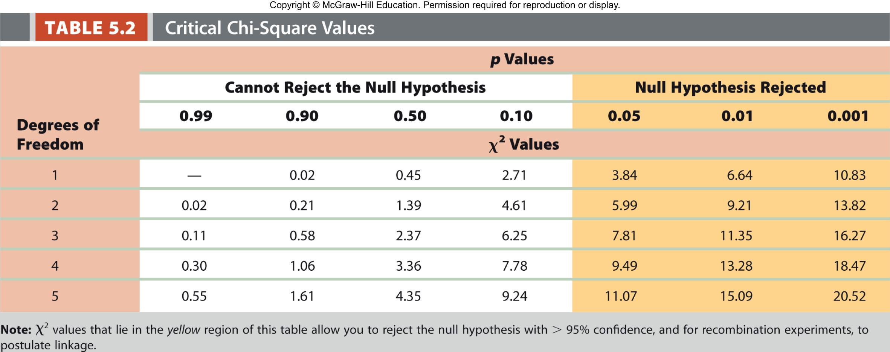
Critical chi-square values
Use p value of 0.05 as cutoff
Chi-square values that lie in the yellow region of this table allow rejection of the null hypothesis with >95% confidence
If null hypothesis is rejected, then linkage can be postulated
Copyright © McGraw-Hill Education. Permission required for reproduction or display
Hartwell et al., 5th ed., Chapter 5

Slide 39
5.5 Tetrad Analysis in Fungi
Learning objectives:
Explain the meaning of the term “tetrad” as applied to the asci produced by certain fungi.
Differentiate between parental ditype (PD), nonparental ditype (NPD), and tetratype (T).
Describe how the relative numbers of PDs and NPDs can be used to establish linkage.
Explain how ordered and unordered tetrad analysis can map the positions of genes and centromeres.
Copyright © McGraw-Hill Education. Permission required for reproduction or display
Hartwell et al., 5th ed., Chapter 5

Slide 40
Tetrad analysis in fungi
Two model organisms for understanding mechanisms of recombination
Saccharomyces cerevisiae – bakers yeast
Neurospora crassa – bread mold
All four haploid products of each meiosis are contained within an ascus (sac)
Ascospores (haplospores) can germinate and survive as viable haploids that divide by mitosis
Tetrad - four ascospores in a single ascus
Copyright © McGraw-Hill Education. Permission required for reproduction or display
Hartwell et al., 5th ed., Chapter 5

Slide 41
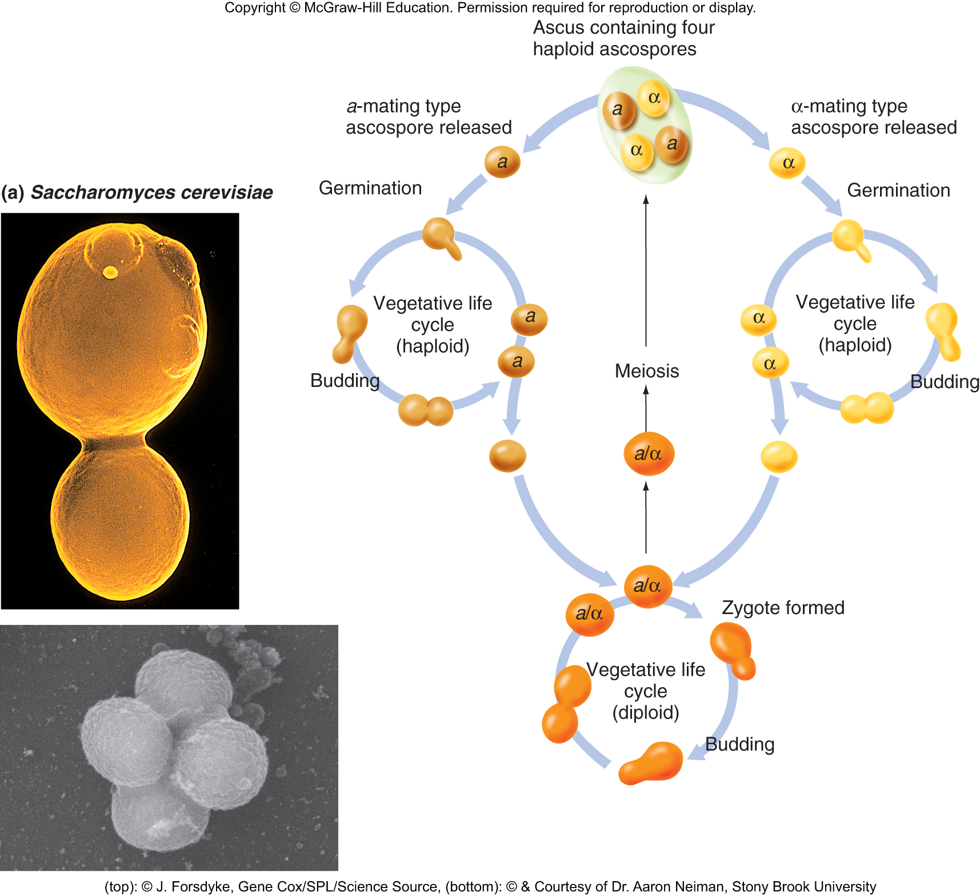
The life cycle of Saccharomyces cerevisiae
Copyright © McGraw-Hill Education. Permission required for reproduction or display
Hartwell et al., 5th ed., Chapter 5

Slide 42
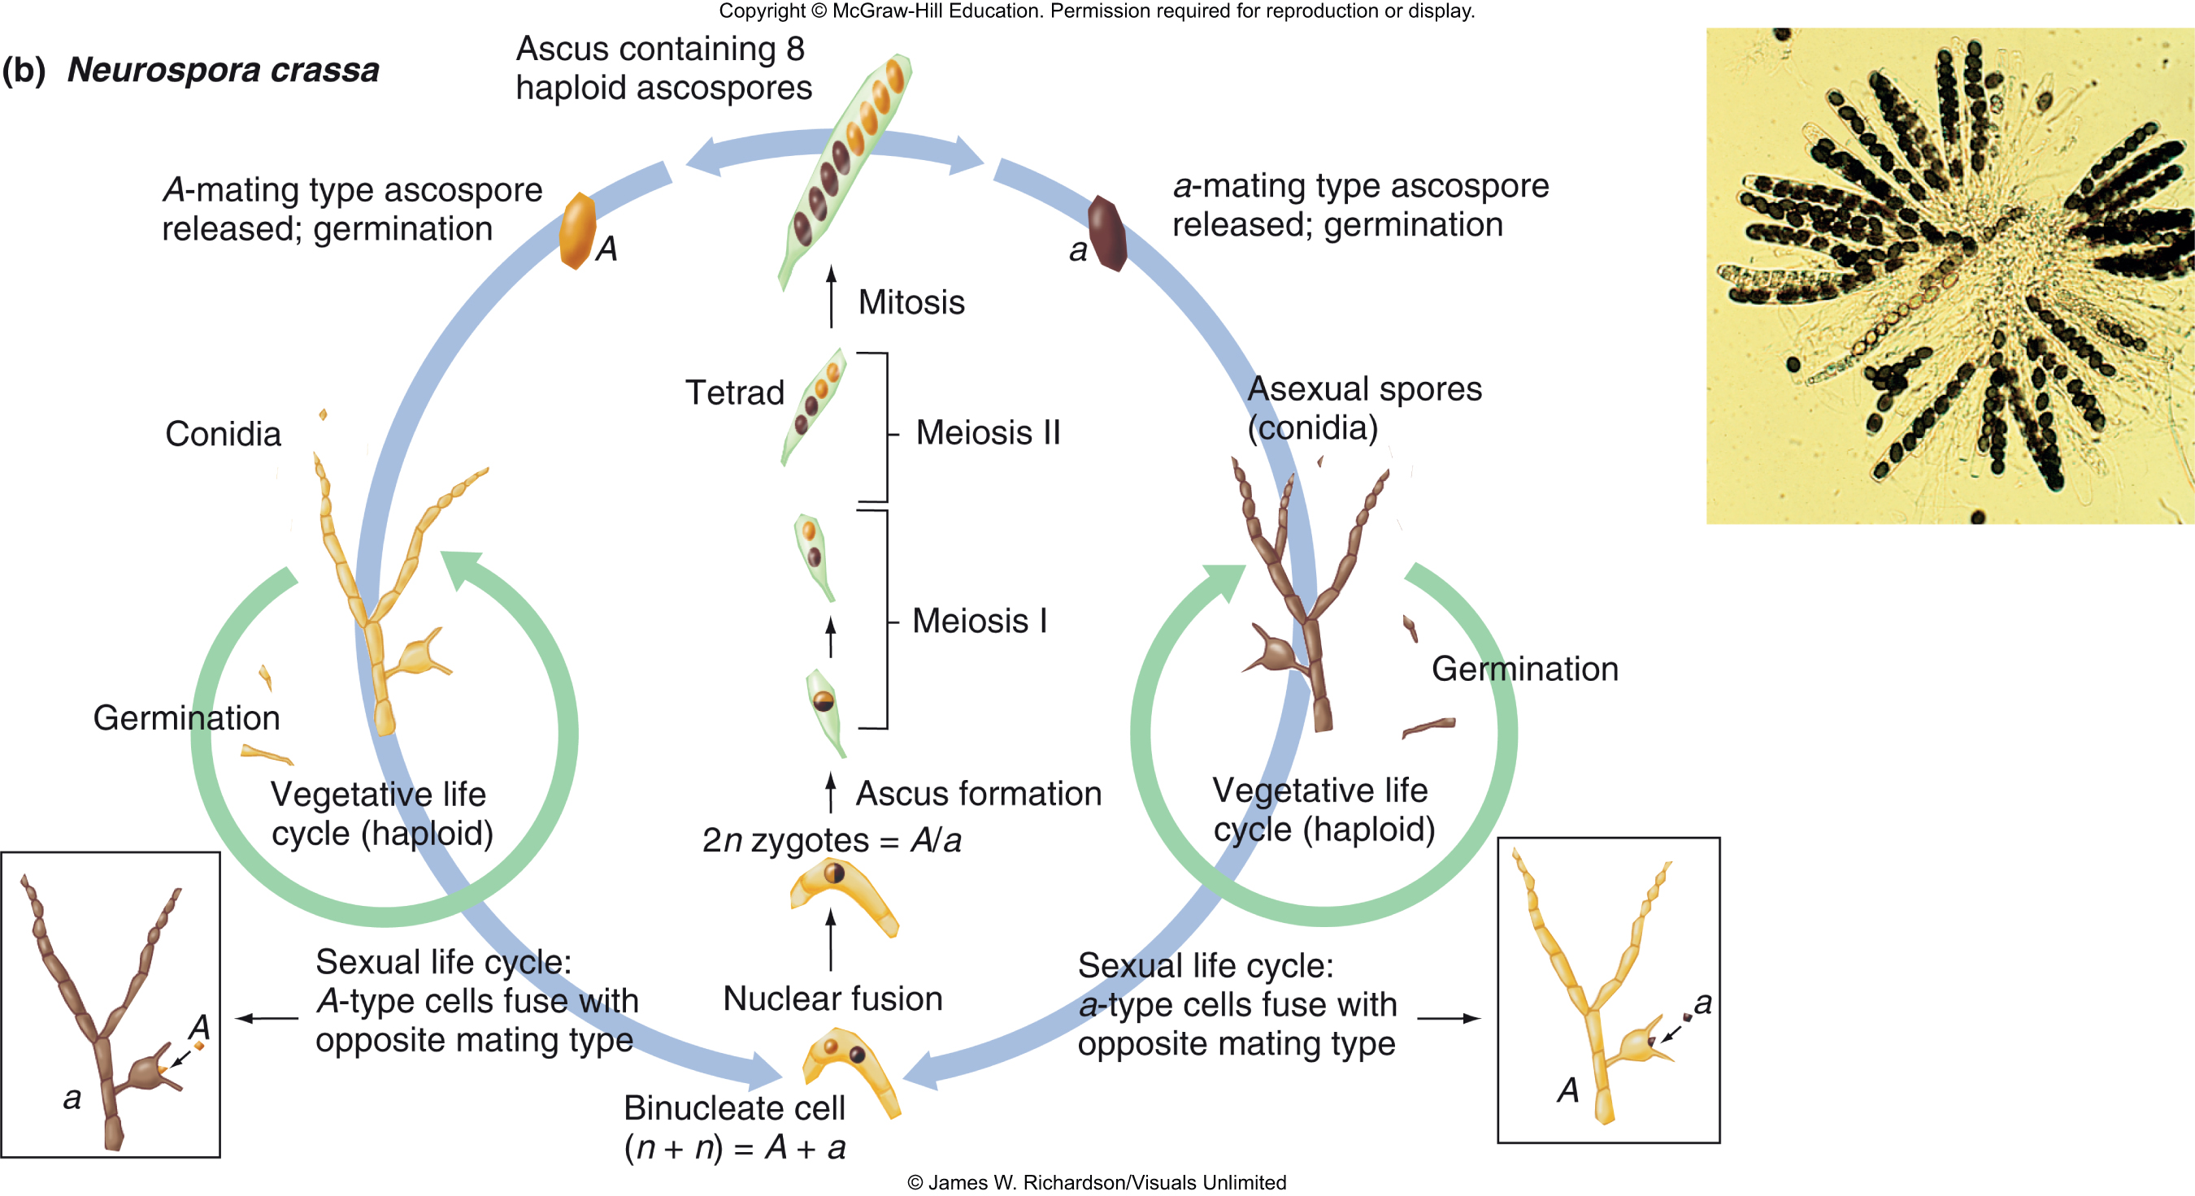
The life cycle of Neurospora crassa
Copyright © McGraw-Hill Education. Permission required for reproduction or display
Hartwell et al., 5th ed., Chapter 5

Slide 43
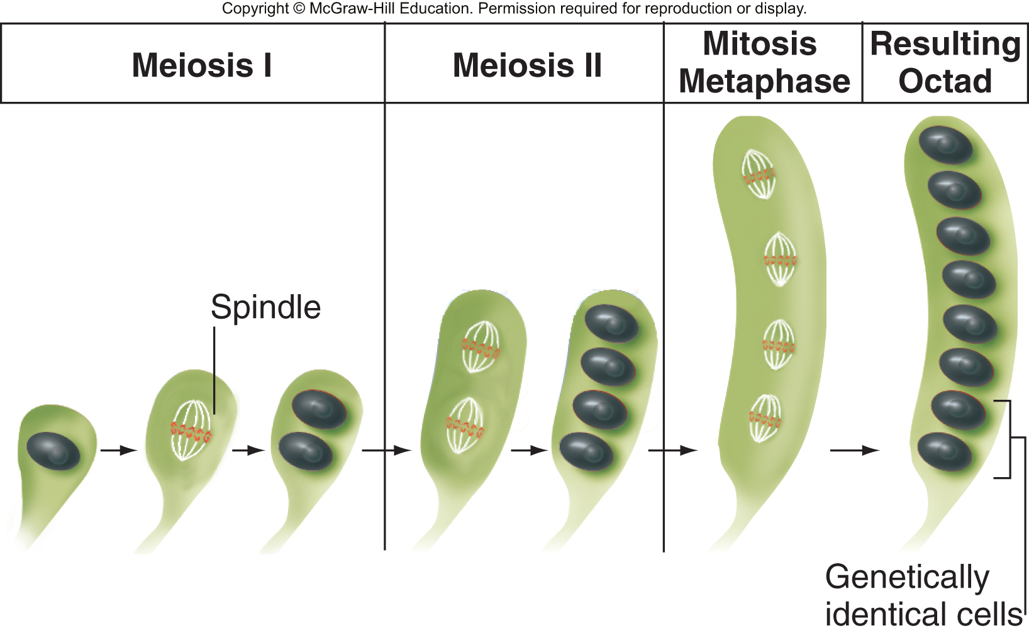
Neurospora form ordered tetrads
Undergo meiosis I and II as usual, but a single round of mitosis after 2nd meiotic division – produces octad
Ascus is very narrow and spindle forms parallel to long axis
Two genetically
identical ascospores
are next to each other
Arrangement of
chromatids can be
inferred from position
of ascospores
Copyright © McGraw-Hill Education. Permission required for reproduction or display
Hartwell et al., 5th ed., Chapter 5

Slide 44
5.6 Mitotic recombination and genetic mosaics
Learning objectives:
Explain how mitotic recombination leads to twin spots.
Describe sectored colonies in yeast and their significance in evaluating mitotic recombination.
Copyright © McGraw-Hill Education. Permission required for reproduction or display
Hartwell et al., 5th ed., Chapter 5

Slide 45
Mitotic recombination can produce genetic mosaics
Rare occurrence through:
Mistakes in chromosome replication
Chance exposure to radiation
Can be observed in yeast and multicellular organisms
C. Stern (1936), inferred existence of mitotic recombination from observations of "twin spots" in Drosophila
Patches of somatic tissue that have different genotypes
Have major repercussions to human health
Copyright © McGraw-Hill Education. Permission required for reproduction or display
Hartwell et al., 5th ed., Chapter 5

Slide 46
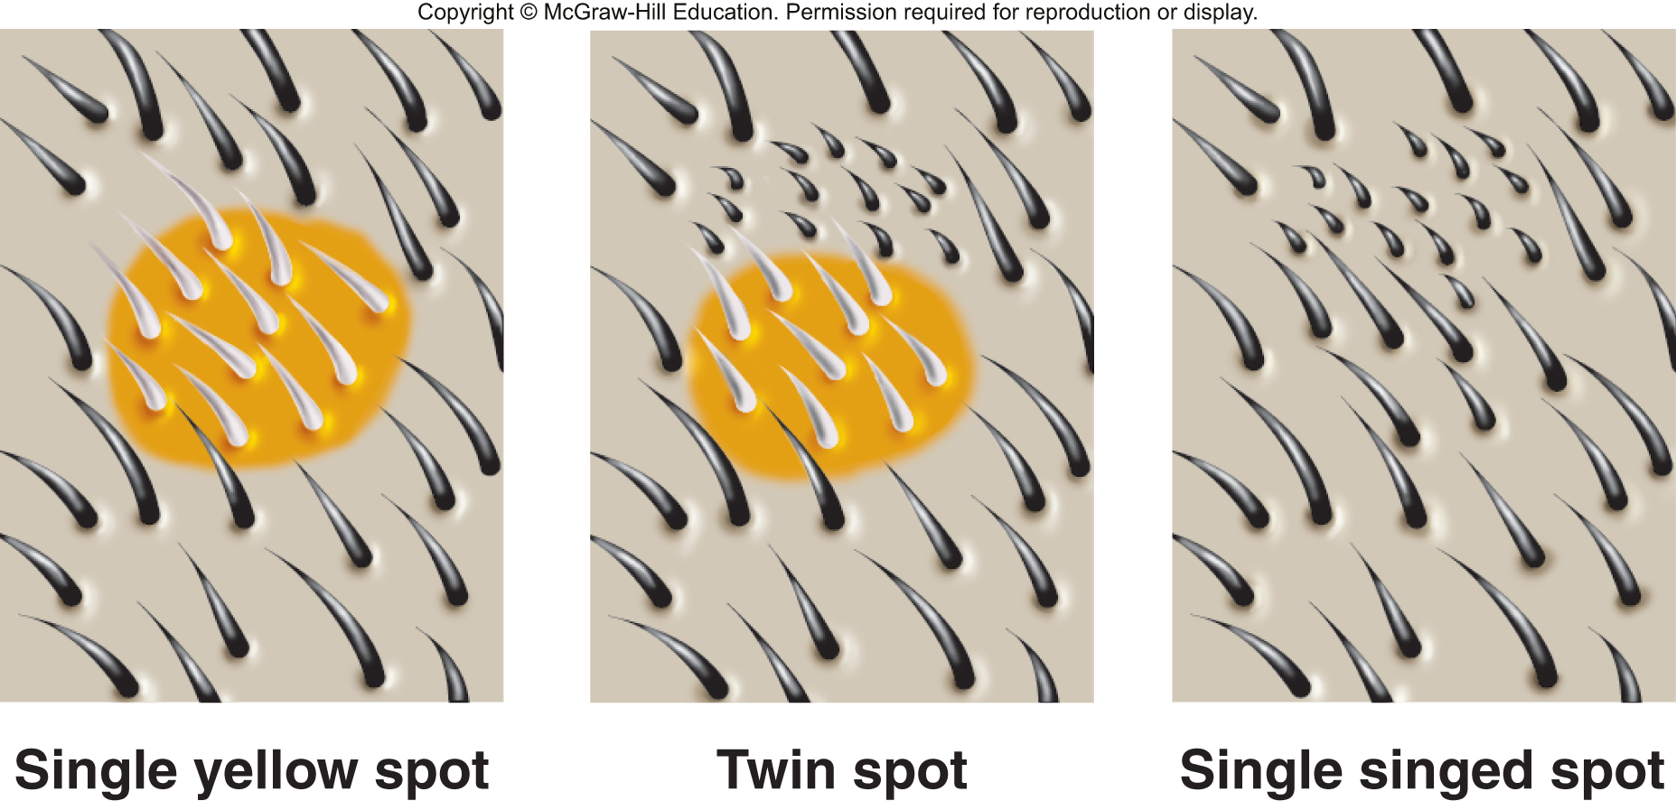
Twin spots are a form of genetic mosaicism
Double heterozygous Drosophila females y sn⁺/y⁺ sn
yellow (y) mutant – yellow body
wildtype (y⁺) – brown body
singed (sn) mutant – short and curled bristles
wildtype (sn⁺) – long and straight bristles
Copyright © McGraw-Hill Education. Permission required for reproduction or display
Hartwell et al., 5th ed., Chapter 5

Slide 47
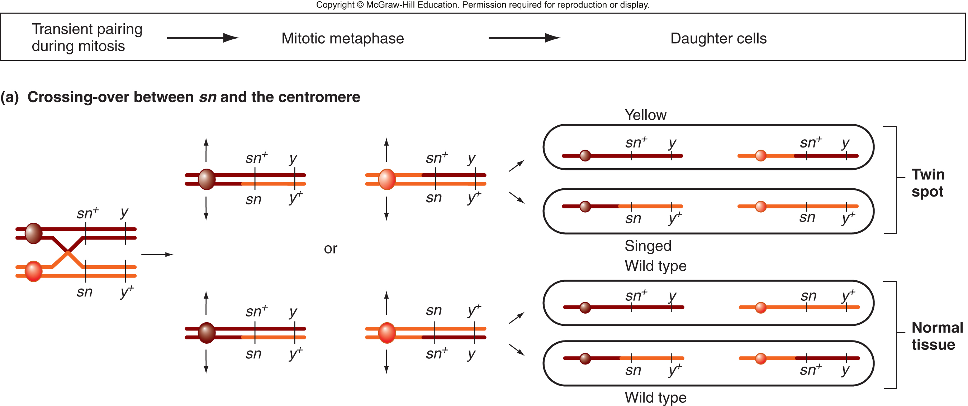
Mitotic recombination results in twin spots
Copyright © McGraw-Hill Education. Permission required for reproduction or display
Hartwell et al., 5th ed., Chapter 5

Slide 48
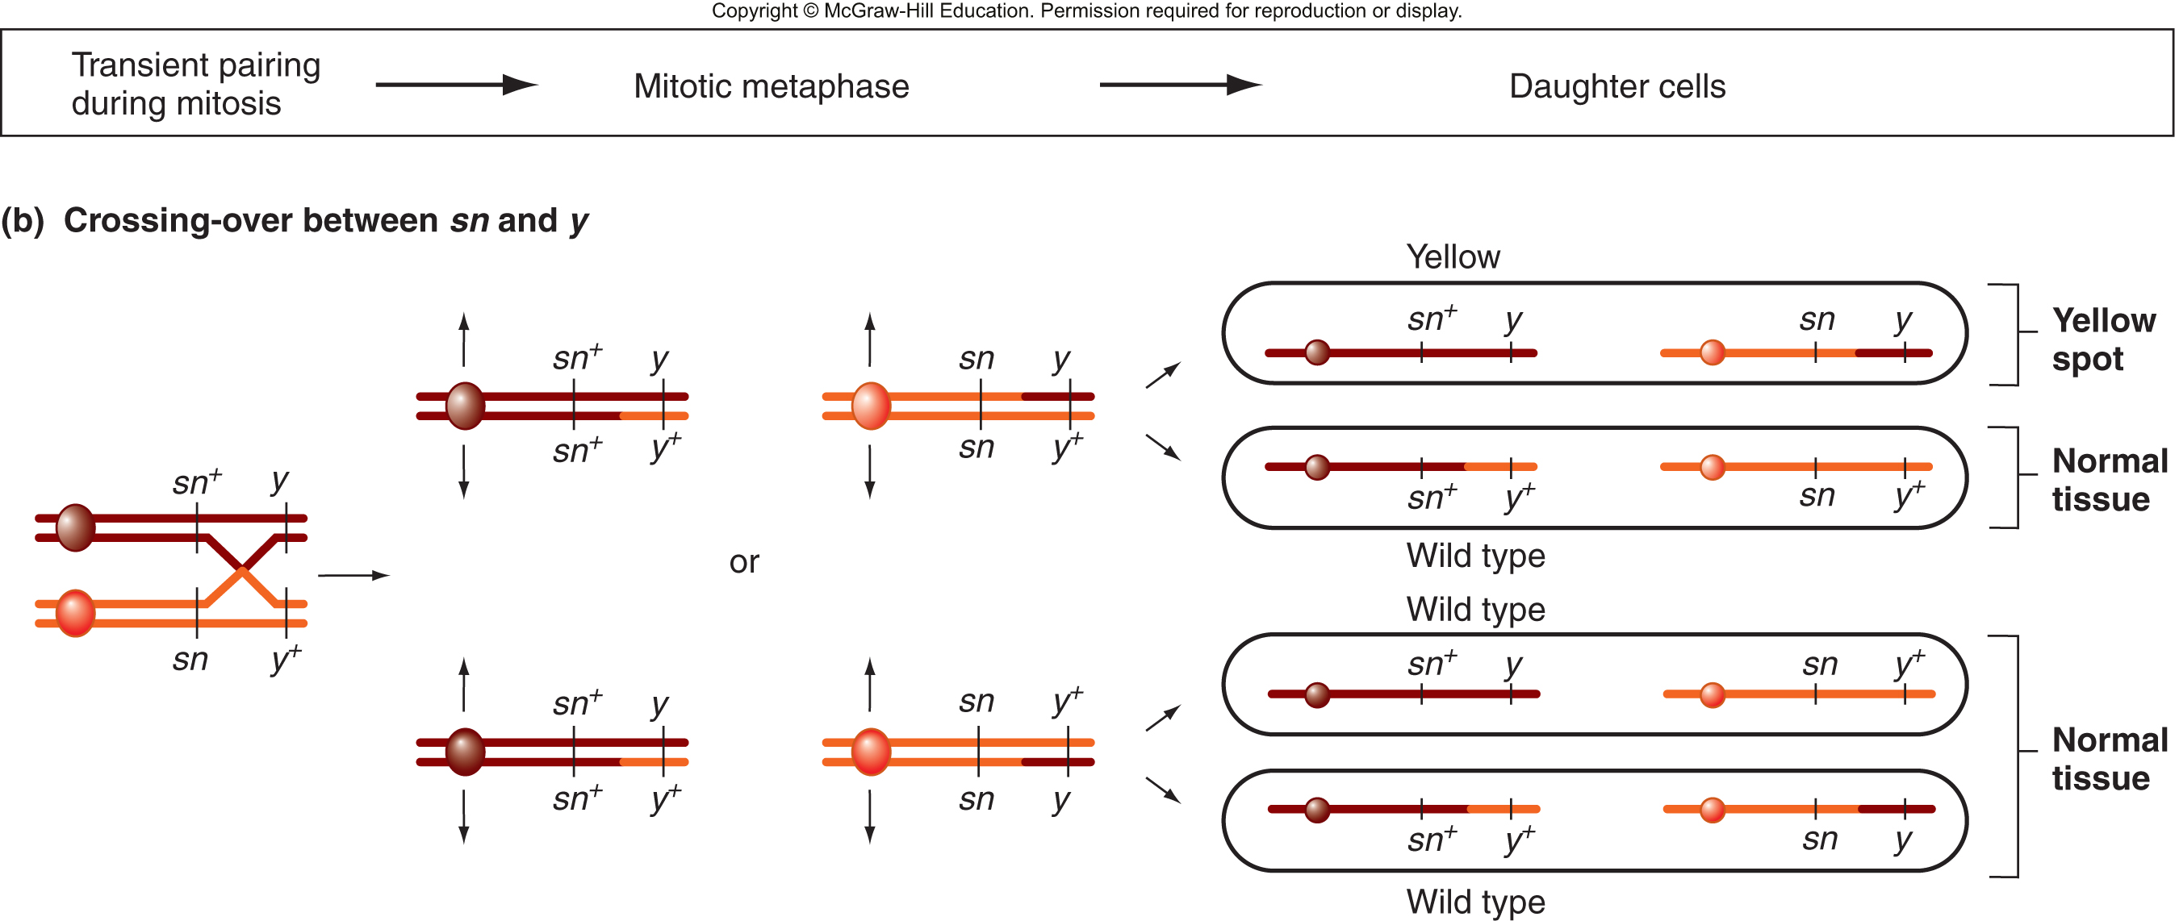
Origin of yellow spots in Drosophila
Copyright © McGraw-Hill Education. Permission required for reproduction or display
Hartwell et al., 5th ed., Chapter 5

Slide 49
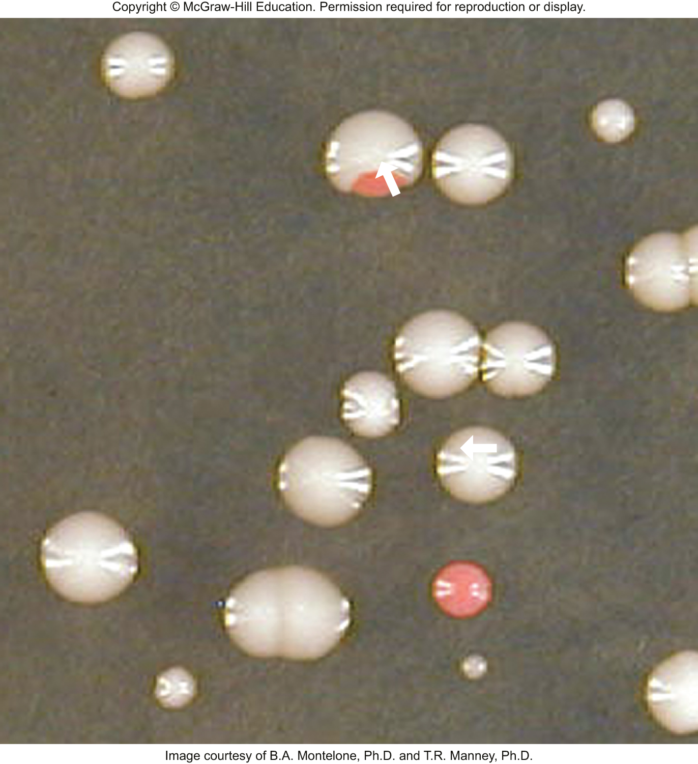
Sectored yeast colonies can arise from mitotic recombination
Diploid ADE2/ade2
White colonies are wildtype
Red sectors are ade2/ade2
Size of sector indicates when recombination took place
Copyright © McGraw-Hill Education. Permission required for reproduction or display
Hartwell et al., 5th ed., Chapter 5

